Slide 1
Adv. Biopharmaceutics
Dr. Mohammed Sabbar
College Of Pharmacy - Basrah
3rd Oct. 2018
http://bit.do/ex2aD

Slide 2
Biopharmaceutics
interrelationship of the Physicochemical - drug, Dosage form,
Route of administration on the rate and extent of systemic drug absorption.
Thus, biopharmaceutics involves factors that influence
(1) The stability of the drug in the product,
(2) The release of the drug from the drug product,
(3) The rate of dissolution/release of the drug at the absorption site, (4) The systemic absorption of the drug.

Slide 3
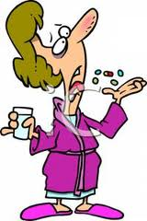
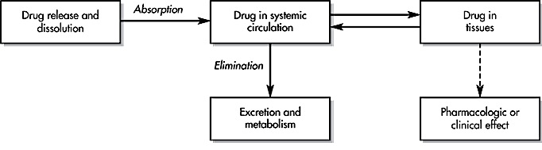
Dissolution
Distribution
A general scheme describing this dynamic relationship

Slide 4
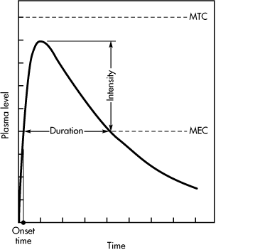
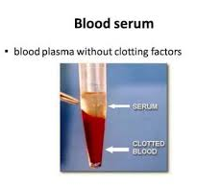
Notes:
minimum effective concentration and minimum toxic concentration of drug
MEC reflects the minimum concentration of drug needed at the receptors to produce the desired pharmacologic effect.
The onset time corresponds to the time required for the drug to reach the MEC
The duration of drug action is the difference between the onset time and the time for the drug to decline back to the MEC
The intensity of the pharmacologic effect is proportional to the number of drug receptors occupied, which is reflected in the observation that higher plasma drug concentrations produce a greater pharmacologic response, up to a maximum.

Slide 5
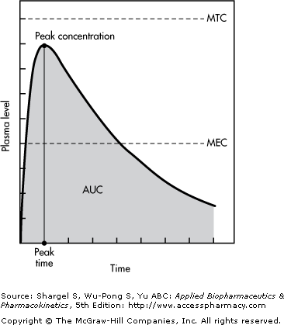
Notes:
The time of peak plasma level is the time of maximum drug concentration in the plasma and is a rough marker of average rate of drug absorption.

Slide 6
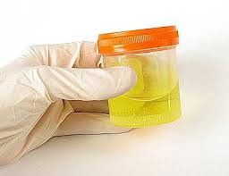
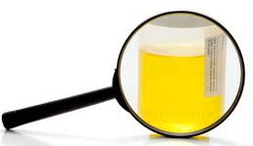
Drug Concentrations in Urine and Feces
Measurement of drug in urine is an indirect method to ascertain the bioavailability of a drug
The rate and extent of drug excreted in the urine reflects the rate and extent of systemic drug absorption
Measurement of drug in feces may reflect drug that has not been absorbed after an oral dose or may reflect drug that has been expelled by biliary secretion after systemic absorption.

Slide 7
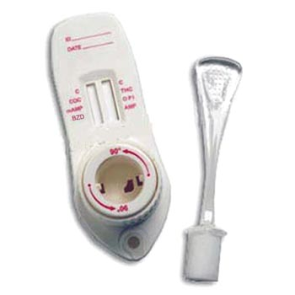
Drug Concentrations in Saliva

Slide 8
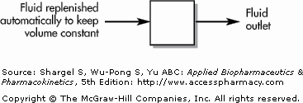
Tank with a constant volume of fluid equilibrated with drug. The volume of the fluid is 1.0 L. The fluid outlet is 10 mL/min. The fraction of drug removed per unit of time is 10/1000, or 0.01 min¹.

Slide 9
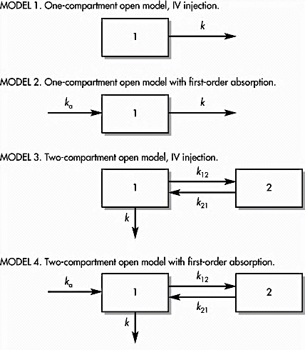
Compartment Models
Notes:
f the tissue drug concentrations and binding are known, physiologic pharmacokinetic models, which are based on actual tissues and their respective blood flow, describe the data realistically. Physiologic pharmacokinetic models are frequently used in describing drug distribution in animals, because tissue samples are easily available for assay. On the other hand, tissue samples are often not available for human subjects, so most physiological models assume an average set of blood flow for individual subjects.

Slide 10
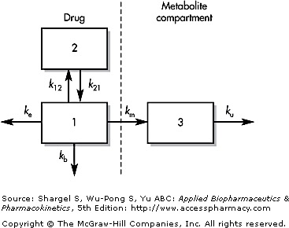
Catenary Model (Mammillary)
K₁₃
K₃₁

Slide 11
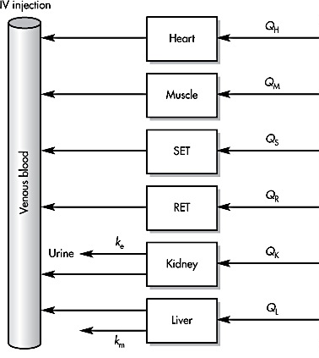
Physiologic Pharmacokinetic Model (Flow Model)
Notes:
also known as blood flow or perfusion models, are pharmacokinetic models based on known anatomic and physiologic data
RET (rapidly equilibrating tissue) and SET (slowly equilibrating tissue).

Slide 12
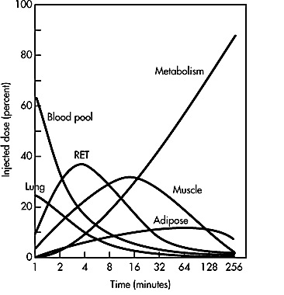
Perfusion model simulation of the distribution of lidocaine in various tissues and its elimination from humans following an intravenous infusion for 1 minute.
Notes:
RET (rapidly equilibrating tissue)

Slide 13
Pharmacokinetic models ???
Notes:
Such mathematical models can be devised to simulate the rate processes of drug absorption, distribution, and elimination to describe and predict drug concentrations in the body as a function of time. Pharmacokinetic models are used to:

Slide 14
Pharmacokinetic models are used to:
1. Predict plasma, tissue, and urine drug levels with any dosage regimen
2. Calculate the optimum dosage regimen for each patient individually
3. Estimate the possible accumulation of drugs and/or metabolites
4. Correlate drug concentrations with pharmacologic or toxicologic activity
5. Evaluate differences in the rate or extent of availability between formulations (bioequivalence)
6. Describe how changes in physiology or disease affect the absorption, distribution, or elimination of the drug
7. Explain drug interactions
Notes:
Such mathematical models can be devised to simulate the rate processes of drug absorption, distribution, and elimination to describe and predict drug concentrations in the body as a function of time. Pharmacokinetic models are used to:

Slide 15
THE BIOPHARMACEUTICS CLASSIFICATION SYSTEM “BCS”
Class 1: High Solubility – High Permeability
Class 2: Low Solubility – High Permeability
Class 3: High Solubility – Low Permeability
Class 4: Low Solubility – Low Permeability
Notes:
The BCS is a scientific framework for classifying drug substances based on their aqueous solubility and intestinal permeability. When combined with the dissolution of the drug product, the BCS takes into account three major factors that govern the rate and extent of drug absorption from IR solid oral dosage forms: (1) dissolution, (2) solubility, and (3) intestinal permeability.5 According to the BCS, drug substances are classified as follows:

Slide 16
Biowaiver
A Biowaiver means that in vivo bioavailability and/or bioequivalence studies may be waived (not considered necessary for product approval)
Ref:
By FDA (Waiver of In Vivo Bioavailability and Bioequivalence Studies for Immediate-Release Solid Oral Dosage Forms Based on a Biopharmaceutics Classification System Guidance for Industry)

Slide 17
Absorption of drugs from GIT and mechanisms
GIT lumen is generally composed from lipoprotein membrane that which the cell structure contain both hydrophilic and lipophilic groups
The absorption of drug in general from GIT is predominant for lipophilic drugs (lipophillic in nature that has high partition coefficient)
About 90% of drugs are weak acids or bases
Free form-not ionized
pH & pKa of drug

Slide 19
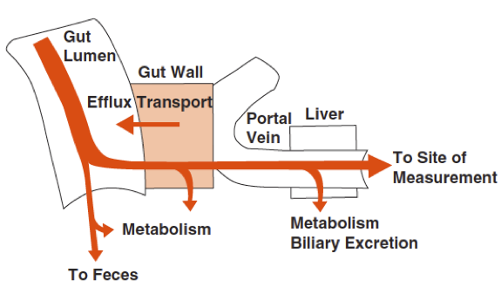

Slide 20
Thank you

